Slide 1

Smart Door System
PYTHON COMPONENTS

Slide 2
Created by :
Abdelraouf Shinkada 192239
&
Abdulali Elmgalish 192118
Developed by :
Abdelraouf Shinkada
Under The Supervision of
Dr.Ahmed Al-Najah

Slide 3



العناصر المستخدمة في جزء البايتون (SOFTWARE)
1
2
3
4
5
6
PYTHON
Tkinter
Camera integration
Threading
CAMERA
Serial USB Connection
7
8
Telegram bot
Face recognition

Slide 4

1
PYTHON

Slide 5


Details of the first element: python
The following table shows the following information :
NAME | python
TYPE | 3.11

Slide 6

2
TKINTER

Slide 7


Details of the second element: tkinter
The following table shows the following information :
NAME | tkinter
TYPE | (GUI)

Slide 8
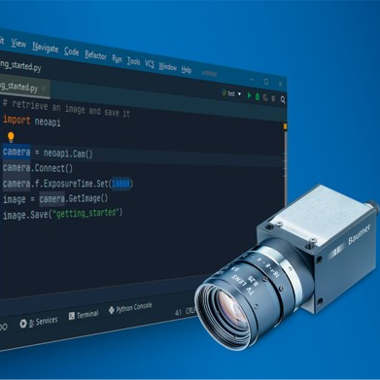
3
CAMERA INTEGRATION

Slide 9
Details of the third element: camera integration
The following table shows the following information :
NAME | camera integration
TYPE | openCV

Slide 10

4
THREADING

Slide 11
Details of the fourth element: Threading
The following table shows the following information :
NAME | Threading
TYPE | -

Slide 12
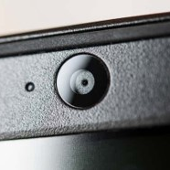
5
CAMERA

Slide 13
Details of the fifth element: Camera
The following table shows the following information :
NAME | Camera
TYPE | pc

Slide 14
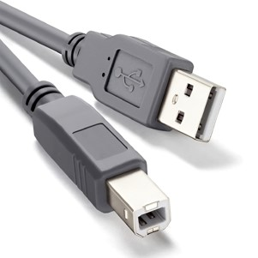
6
SERIAL USB CONNECTION

Slide 15
Details of the sixth element: Serial USB connection
The following table shows the following information :
NAME | Serial USB connection
TYPE | USB

Slide 16

7
TELEGRAM

Slide 17
Details of the seventh element: Telegram
The following table shows the following information :
NAME | Telegram
TYPE | Bot & group

Slide 18
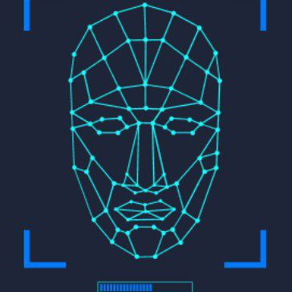
8
FACE RECOGNITION

Slide 19
Details of the eighth element: face recognition
The following table shows the following information :
NAME | face recognition
TYPE | dlib

Slide 20
THANKS
FOR
LISTENING

Slide 21
THANKS
FOR
LISTENING

Slide 22
THANKS FOR LISTENING

